Slide 1





IOT-BASED SINGLE-AXIS SOLAR TRACKER WITH BATTERY MONITORING AND CLOUD DASHBOARD

Slide 2

MEMBER
HOÀNG TIẾN MẠNH-SE203727
VÕ ĐẶNG ANH KHOA-SE203865
ĐẶNG THỊ PHƯƠNG ANH-SE203874
NGUYỄN THÀNH LUÂN-SE184179

Slide 3

  INTRODUCTION
Fixed panel
  Peaks only around solar noon; cosine loss grows quickly in the morning and afternoon.
Sun tracking
  Studies report roughly 20–40% more energy than a fixed panel.
Why single-axis
  One actuator, one hinge and simple control; a good fit for low-power prototypes.
Sensor-driven closed loop: no GPS, real-time clock or site calibration needed.

Slide 4
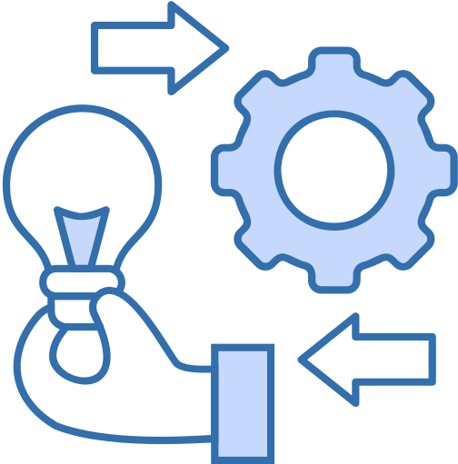

  METHOD AND MATERIALS
  Microcontroller: ESP32-S3 DevKit N16R8 (integrated Wi-Fi, dual-core processor, 12-bit ADC).
  Light Sensors: Four photoresistor (LDR) sensor modules mounted at the four corners to measure light intensity differences.
Power System:
  5W solar panel.
  TP4056 charging module (with battery protection).
  One 18650 Li-ion cell (2500 mAh).
  MT3608 buck converter adjusted to 5V to exclusively supply the servo motor, preventing motor current from causing voltage drops in the microcontroller.
  Micro Servo SG90: Rotation solar panel to where has most lightest .

Slide 5
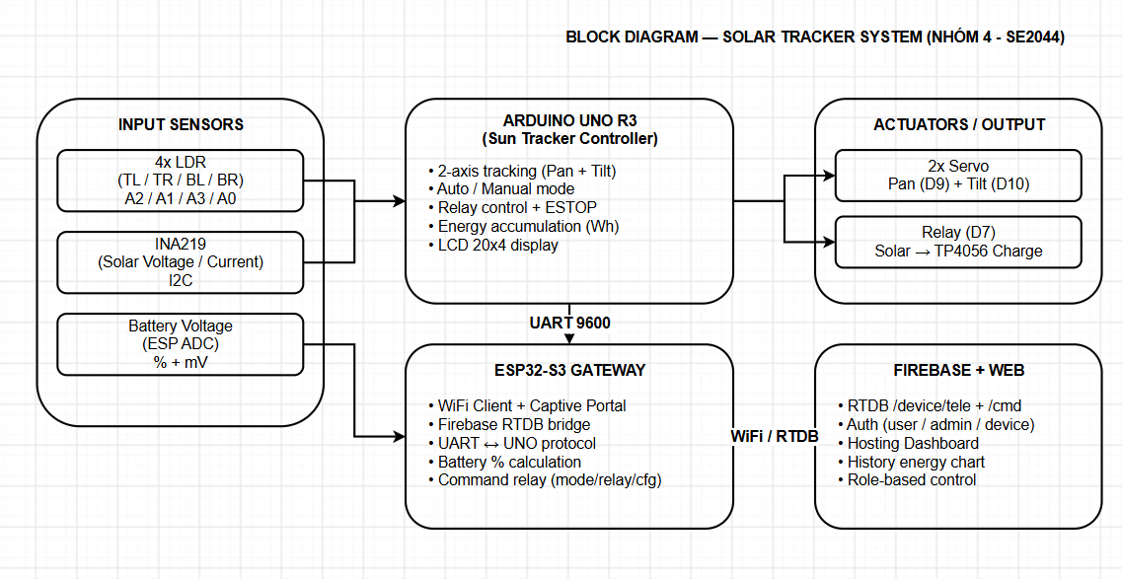
2.1 BLOCK DIAGRAM

Slide 6
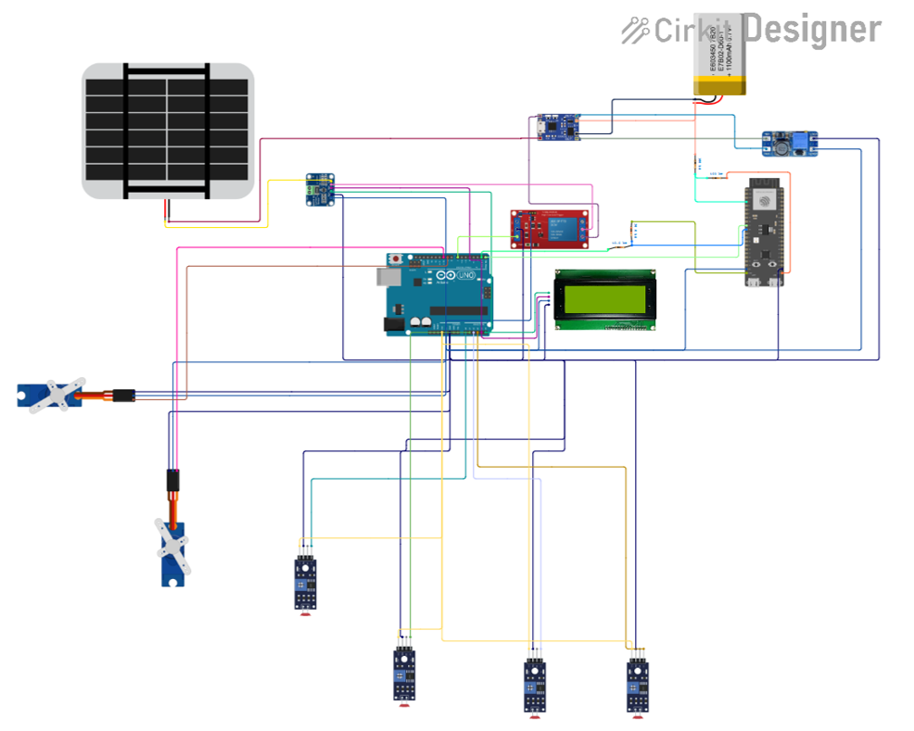
  ELECTRONIC
CIRCUIT

Slide 7
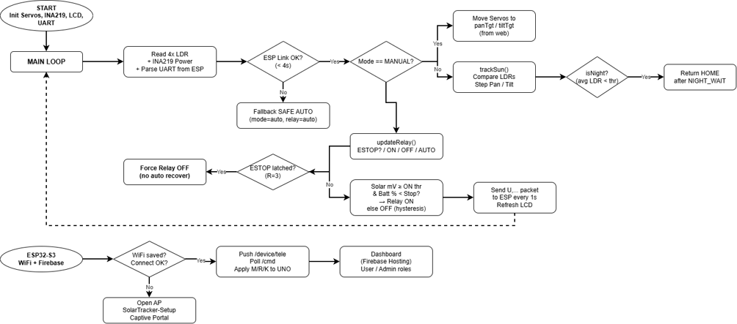
  FLOWCHART

Slide 8
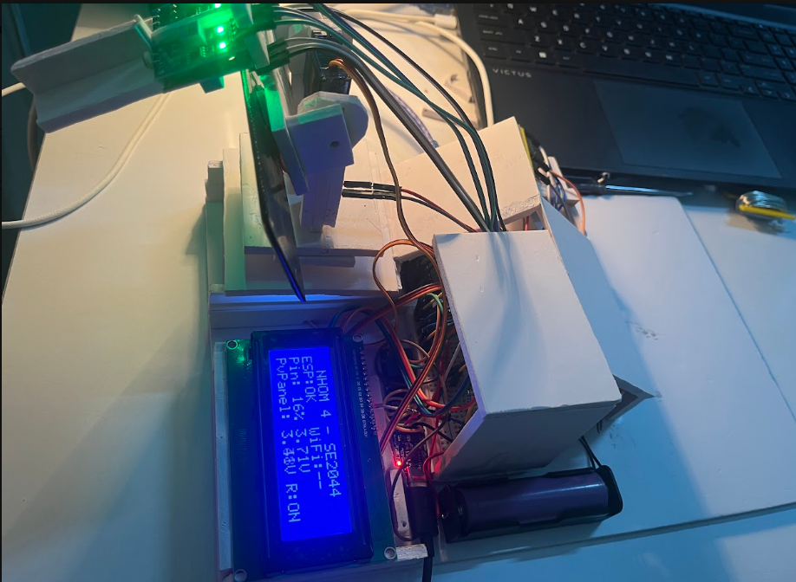
LẮP MẠCH

Slide 9
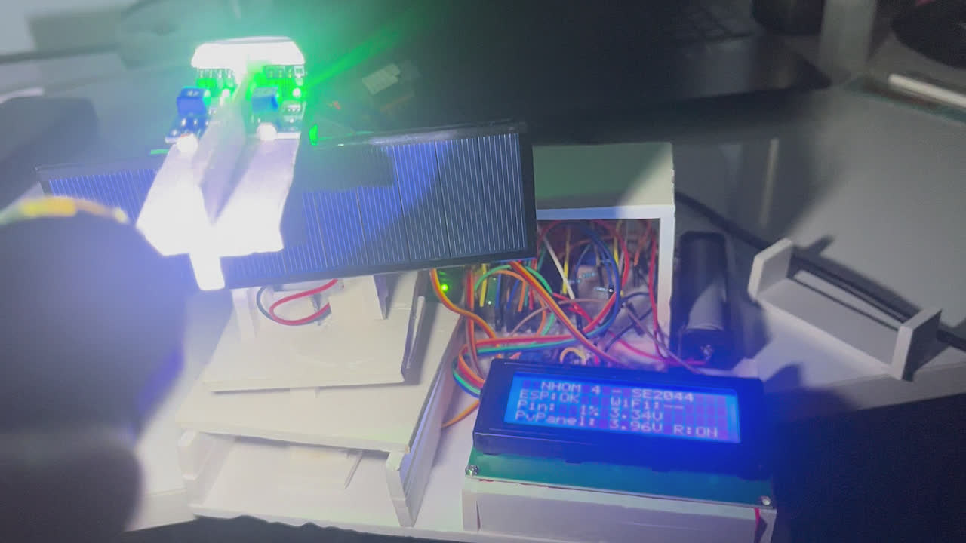

Slide 11
5. RESULTS AND CONCLUSION
  Prototype Testing: The system operates stably with smooth rotation, avoiding continuous oscillation thanks to the implemented deadband hysteresis.
  The project has successfully built a low-cost single-axis solar tracking system that optimizes solar energy harvesting, integrates comprehensive hardware/software safety protection mechanisms, and provides online IoT monitoring.

Slide 12

THANK YOU!

